Slide 1
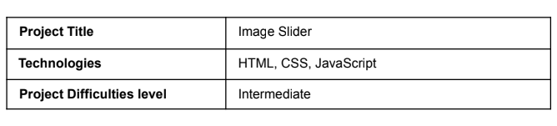
PROJECT 2(BASIC) –IMAGE SLIDER
- SUBMITTED BY
PRNICE DEEPAK J K

Slide 2
Introduction :
The image slider project focuses on building a straightforward image carousel
with HTML, CSS, and JavaScript. It includes forward and backward arrows for
manual navigation, automatically transitions to the next image every 5 seconds,
and features navigation dots at the bottom for users to directly select and view
specific slides.

Slide 3
Project Requirements:
Develop a responsive image slideshow.
Use HTML, CSS, and JavaScript.
Display a series of images in a slideshow format.
Include navigation controls for moving forward and backward.
Ensure the slider adapts to different screen sizes.

Slide 4
Project Structure:
index.html: The primary HTML file for the project.
styles.css: The CSS file for slider styling.
script.js: The JavaScript file for slider interactivity.
images: A directory containing the images for the slider.

Slide 5
Project Features:
Displays a series of images in a slideshow format.
Includes navigation controls to move forward and backward through the images.
Responsive design adapts to different screen sizes.
JavaScript adds interactivity for user navigation.
Allows seamless navigation through the images.

Slide 6



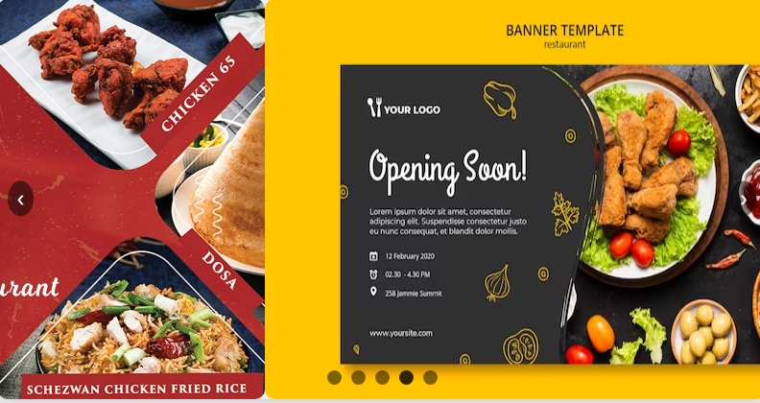
OUTPUT SCREEN:
PAGE 1:
PAGE 2:
PAGE 3:
PAGE 4:

Slide 7
Conclusion:
The image slider project illustrates how to use basic HTML, CSS, and JavaScript to build a simple image slider featuring a horizontal sliding animation effect. It highlights the importance of mastering DOM manipulation with JavaScript and creating smooth animations with CSS transitions.

